Slide 1
Group 8: LifeLine
Amy Jacob
Max Hickey
Luke Dowling
Allan
Kantelberg
Stephen
Mahady
Micheal Cherry

Slide 2
Problem Area: Communications
We want to give more independence and security to our users
“After I broke my hip I was lying on the floor for 4 hours with no way to contact anybody”
66%
Two-thirds of respondents from our
survey said emergency communication
methods needed to be improved

Slide 3
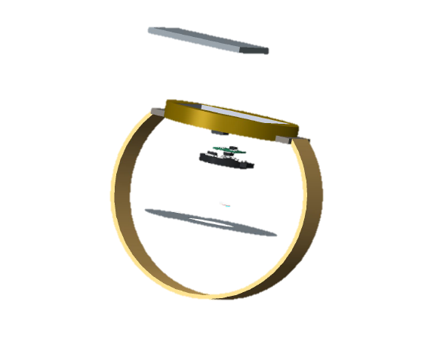
Our Solution:
Lifeline is a device worn on the wrist that acts as a link between the user and their carer in the case of an emergency
LifeLine
“Wearable monitoring device with integrated alert system”
User
LifeLine
Carer

Slide 4
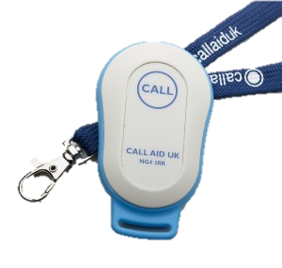
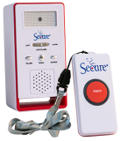
Existing Solutions: “Panic Button”
One Response
Difficult To Use
Require User Impulse
Stigmatizing
Not Handheld or Portable

Slide 5
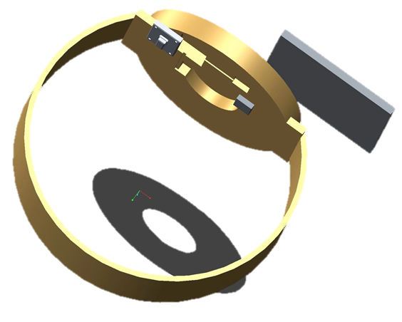
LifeLine
Touchpad
Accelerometer
Heart Rate Monitor

Slide 6
How Does it Work?
Monitors heart rate
Tracks user movement
User friendly touchpad for manual alert
Information sent to Nurses Station

Slide 7
Accelerometer
Heart Rate
Monitor
Touchpad
Accident or Fall
Heart-Attack or
Stroke
Manual Alert
Integrated Alert

Slide 8
Benefits
1. INFORMATIVE
2. USER FRIENDLY
3. AUTOMATIC
4. SECURITY
5. DISCREET

Slide 9
Future Development
Stages:
Nursing homes → Carer Alert Devices
Temporary Care → Pager of Part-Time Nurse
Users Living Alone → Family/
Emergency Contact
Safety and Independence for Users

